Slide 1
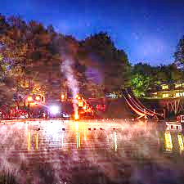
IT’S TIME
Marriage Camp
June 14-15
Bethany Camp
Sinclairville, Western NY
MarriageCamp2024.ezregister.com

Slide 2
Marriage Camp June 14-15 Bethany Camp Sinclairville, Western NY
MarriageCamp2024.ezregister.com

Slide 3
Ecclesiastes 3:1 - To everything there is a season, a time for every purpose under heaven.
Ecclesiastes 3:11 - He has made everything beautiful in its time.

