Slide 1
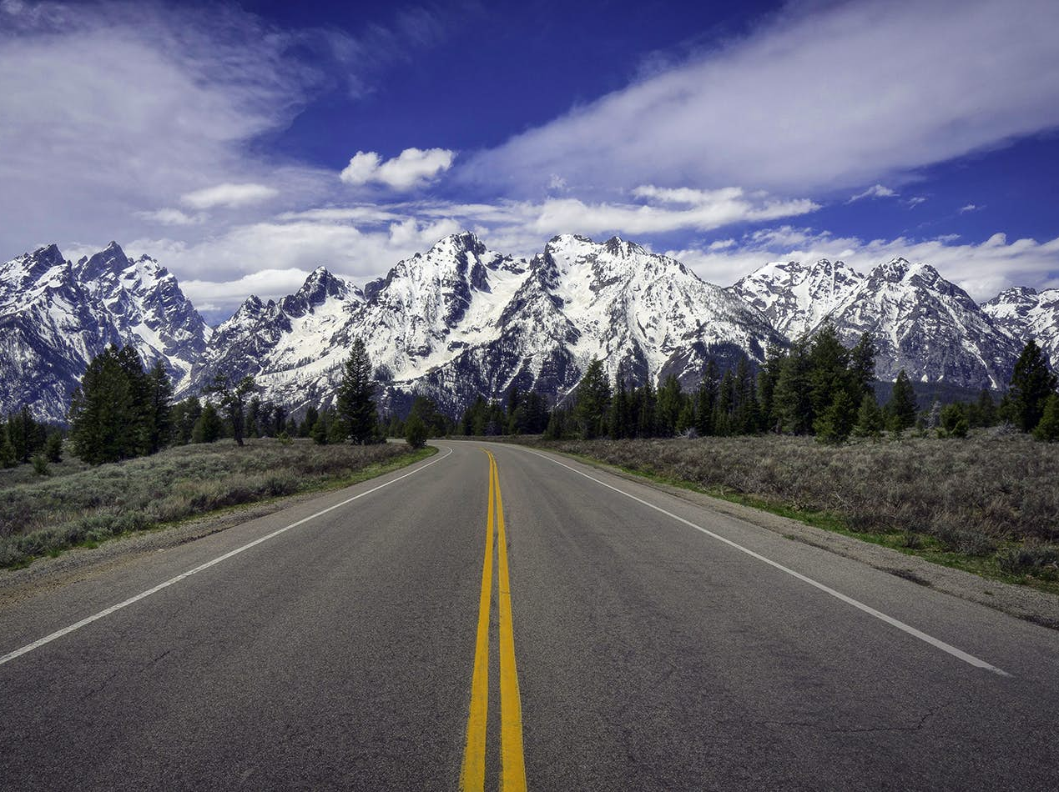
CONQUER THE MOUNTAIN
Overcoming Anger, Lust, and Pride
FEBRUARY 21-22, 2025

