Slide 1
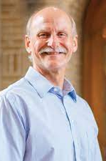
NF FALL CONFERENCE October 21-22 NF2024.ezregister.com
GODLY LEADERSHIP
in a
GODLESS AGE
I Corinthians
Ken Gardoski
First Baptist
Memphis, NY

