Slide 1
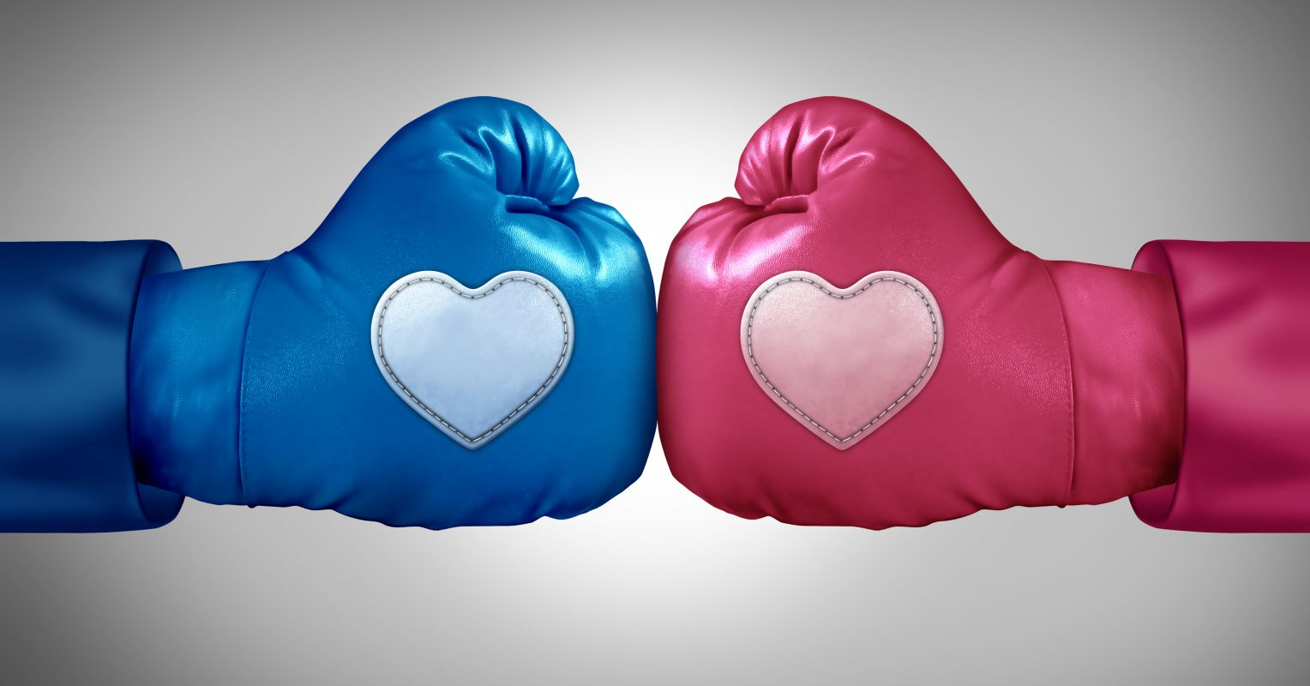
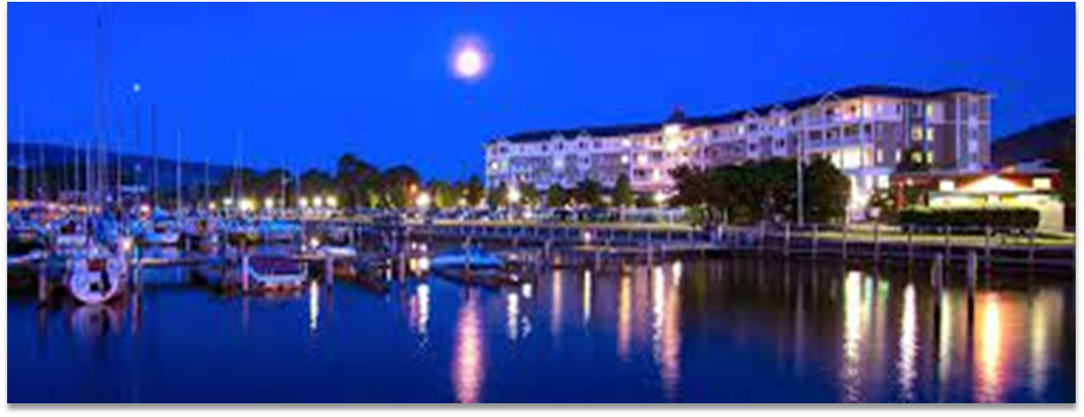
FIGHTING FAIR
Marriage Refresh, Main Speaker Elijah Beltz
December 26-27, Harbor Hotel - Watkins Glen

